Slide 1
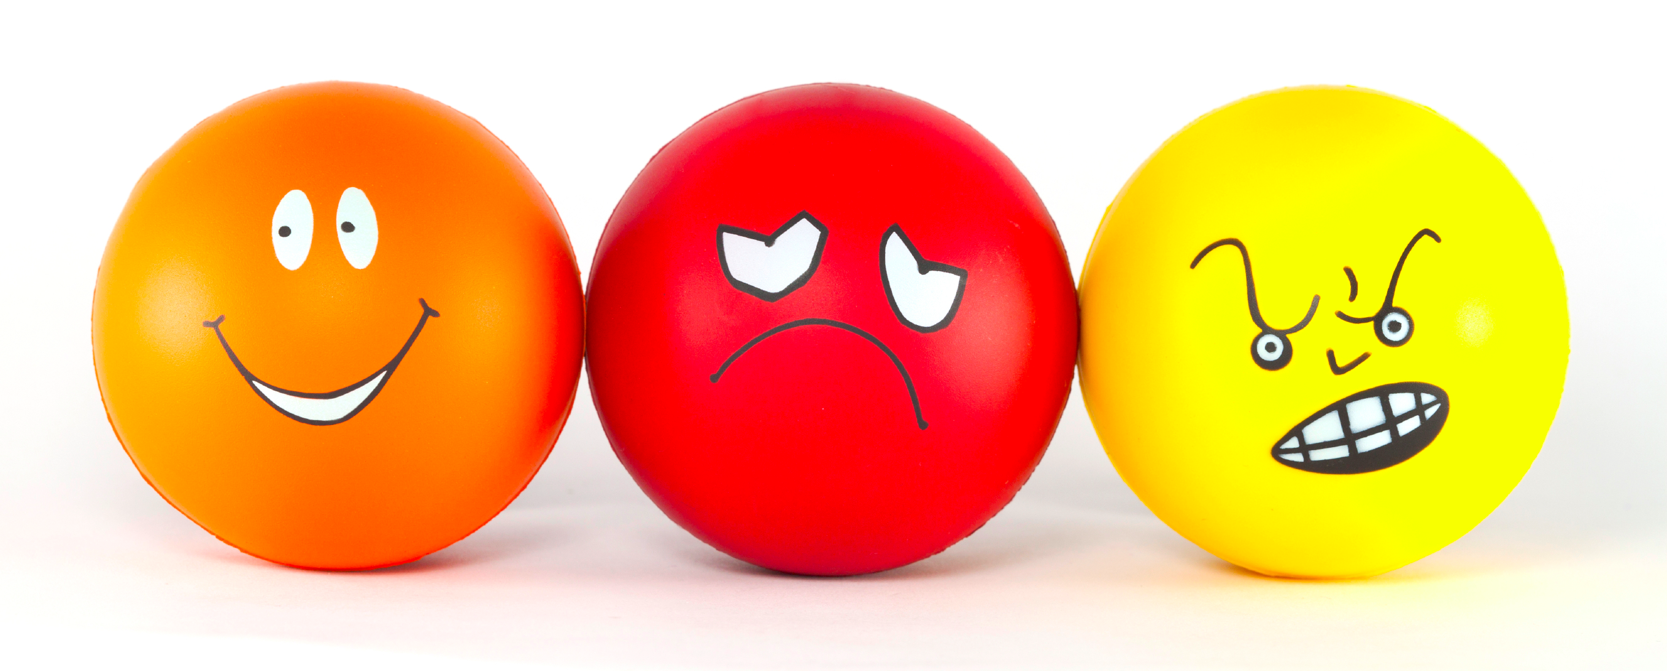
Generating Emotional Impact in Stories
Lydia Chilton & Jessica Ouyang
6 April 2015

Slide 2
Emotional impact is the magic of storytelling.
Notes:
Quite simply, emotional impact is the magic of story telling.

Slide 3
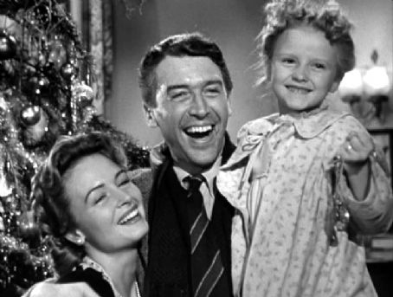
Notes:
As cheesy as they are, people love a happy ending

Slide 4
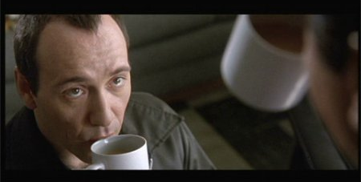
Notes:
There’s a thrill at a surprise twist

Slide 5
Emotions drive us to actions.
Notes:
Quite simply, emotional impact is the magic of story telling.

Slide 6

Hunger drives us to seek food.

Slide 7
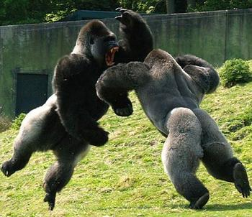
Anger drives us to fight

Slide 8

Confusion drives us to ask questions

Slide 9
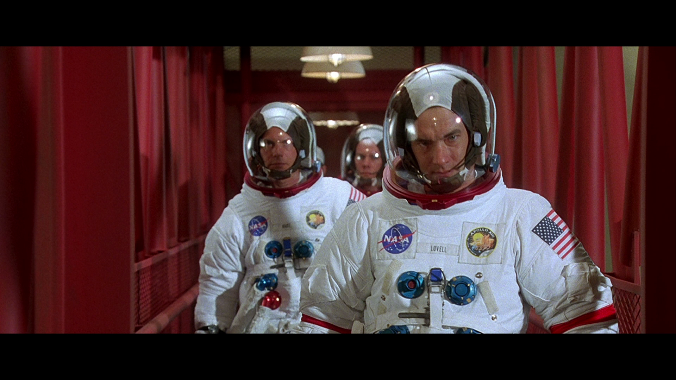
Awe inspires us to become astronauts.

Slide 10
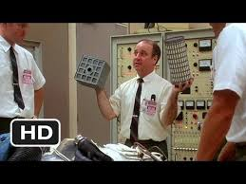
…or engineers.

Slide 11
Emotional impact drives information seeking behavior.
Notes:
Quite simply, emotional impact is the magic of story telling.

Slide 12
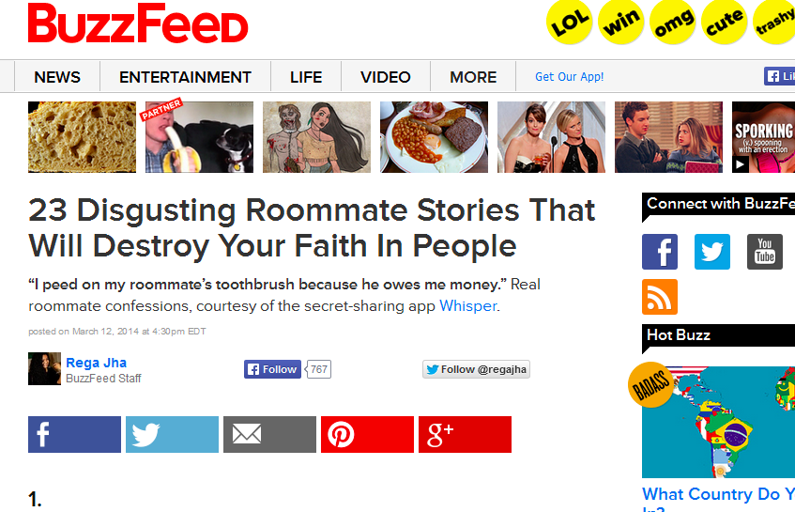
Notes:
A lot of media drives negative behavior. Anger seems easier to trigger than Happyness.

Slide 13


Slide 14
If we are to create media that drives positive behavior, we must understand how to generate emotional impact in narrative.
Notes:
Quite simply, emotional impact is the magic of story telling.

Slide 15
How?
Find models of emotional from the literature
Test them against data
Present the models to people to see if they are useful and effective in generating emotional impact.
2 Cases:
News Satire
Dramatic Personal Narratives

Slide 16


Two Domains
Dramatic Personal Narratives
Examples of models
how they are tested computational
Humor in News Satire
How tested models are used by people to generate humor.

Slide 17
Generating News Satire
Notes:
Quite simply, emotional impact is the magic of story telling.

Slide 18
Models of Humor
Insult
Exaggeration
Reversal
“2 Script Theory”
“I married Miss Right. I didn’t know her first name was always”
We laugh at people, not things.

Slide 19
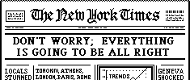
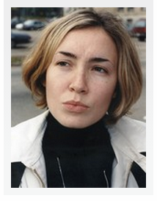
News Satire
New Smartphone Dating App “The League” Matches Elite Professionals
“I don’t know, I feel uncomfortable writing off people based on something other than their looks.”

Slide 20
News Satire as a Search Problem
Headline
New Smartphone Dating App “The League” Matches Elite Professionals
“I don’t know, I feel uncomfortable writing off people based on something other than their looks.”
Joke

Slide 21
News Satire as a Search Problem
Headline
New Smartphone Dating App “The League” Matches Elite Professionals
Point of view
reversal
criticism
“I don’t know, I feel uncomfortable writing off people based on something other than their looks.”
reason
Joke

Slide 22
New Smartphone Dating App “The League” Matches Elite Professionals
Dating Apps
Stanford
Elite Professionals
Good
Bad
POV:
Alumni
POV:
Other school Alumni
Successful, rich, educated people
Elitist, excludes people from their “club”
Criticism Target: Elitist
Criticism Type: POV
POV:
Elitist
POV:
Non-Elites
Expected Reaction
Expected Reason
Expectation Reversal
Reversal
Reason
POV
Example
Elitist
Good
Helps them find love
It doesn’t help them find love
?? ????
It’s not elite enough
Vassar
“How elite are we talking? They aren’t allowing Vassar alums in, are they?”

Slide 23
Timeline
2 Months: build model for stand-alone headlines
6 Build out humor site:
Judgments
Analysis
Ideation
Creation
Improving the model
4 months: Do Generation for Surprise
????

Slide 24
Jessica Ouyang
Labov’s Model of Drama in narrative
Testing it against data
Goal: Turn this into a generative model, similar to humor

Slide 25
The Most Reportable Event
A minimal story consists of a starting state, an ending state, and an event that causes this change of state
A Grammar of Stories: An Introduction, Gerald Prince 1973
To hold an audience’s attention, a personal narrative must contain a Most Reportable Event (MRE), an event that is uncommon and highly impactful
‘Some Further Steps in Narrative Analysis’, William Labov 1997

Slide 26
Example of Most Reportable Event
This isn't exactly creepy, but it's one of the scariest things that's ever happened to me. I was driving down the motorway with my boyfriend in the passenger seat, and my dad in the seat behind my own. My dad is an epileptic and his fits are extremely sporadic. Sometimes he goes extremely stiff and other times he will try to get out of places or grab and punch people. Mid-conversation I felt his hands wrap around my throat as I was driving, pulling my head back and making it increasingly difficult to drive. My boyfriend managed to help steer the car into the hard shoulder but it was one of the scariest experiences in my life.

Slide 27
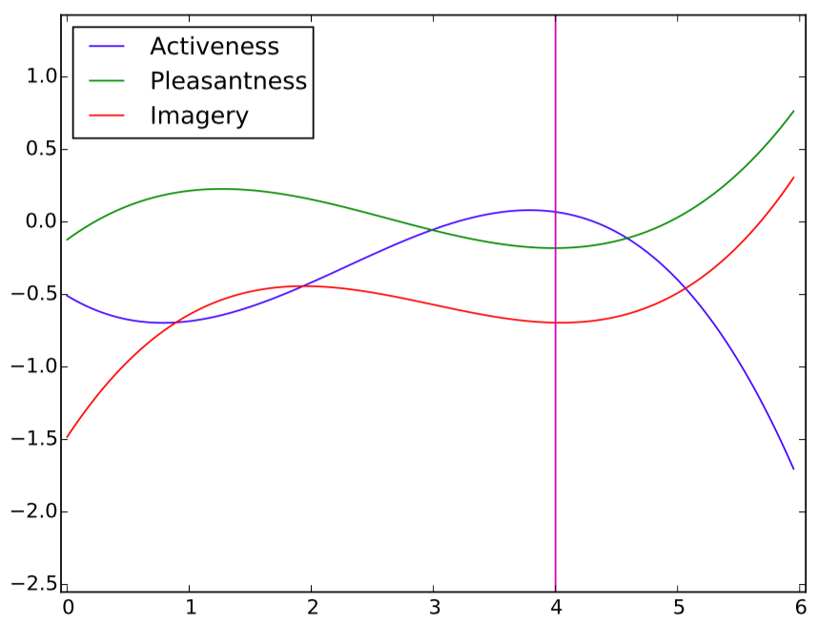
Dictionary of Affect in Language Score
This isn't exactly creepy, but it's one of the scariest things that's ever happened to me.
Sentence Index

Slide 28
Experiments
Data
3,161 narratives (41,773 sentences) collected automatically from Reddit
469 narratives manually labeled with MREs; 2692 automatically labeled using heuristics
Self-training Approach
Initial SVM model trained on manual labels
Iteratively adds automatic heuristic labels to the training set based on agreement with model
Achieves high recall (0.92) but low precision (0.38)

Slide 29
Schedule
Sept-Oct: improve current heuristic labeling
Account for story topic using Reddit post titles
Implement voting among reader comments
Nov-Dec: improve current MRE detection precision
Increase granularity of sentence position binning
Add new splines for average word length, LIWC frequencies
Add long-range spline features
Jan-May: explore other linguistic theories of narrative
Adapt Gee’s theory of speaker/listener interaction to text
Jun: explore other methods for quantifying style
Nye and Nenkova (to appear in NAACL 2015)
July-Aug:
Ranking by reader interest based on up/down-votes and/or sentiment analysis of comments?
Larger-scale interannotator agreement study using Mturk?
Not sure on this one.

Slide 30
If we are to create media that drives positive behavior, we must understand how to generate emotional impact in narrative.
Deliverables:
App and website for volunteers to learn and perform the Humor generation problem
Publish news satire on Twitter
Improve the model to Onion- level Quality
Develop models for stories of Dramatic Personal events
Generalize emotional impact generation to this domain
Videos of the research
Notes:
Quite simply, emotional impact is the magic of story telling.

